Slide 1
Updated Internet Rechartering

Slide 2
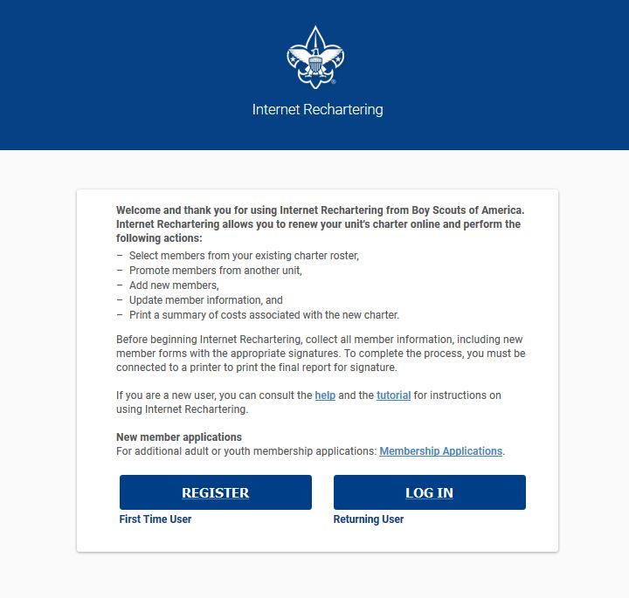
Access codes still distributed by Council
Notes:
Pat: I know that the access codes will still be distributed by Councils, the unit processor will go in as a first time user and register on the system and then can return using their access code and password. And the councils will still get the same reports they have received in the past. So what is changing Debra?

Slide 3
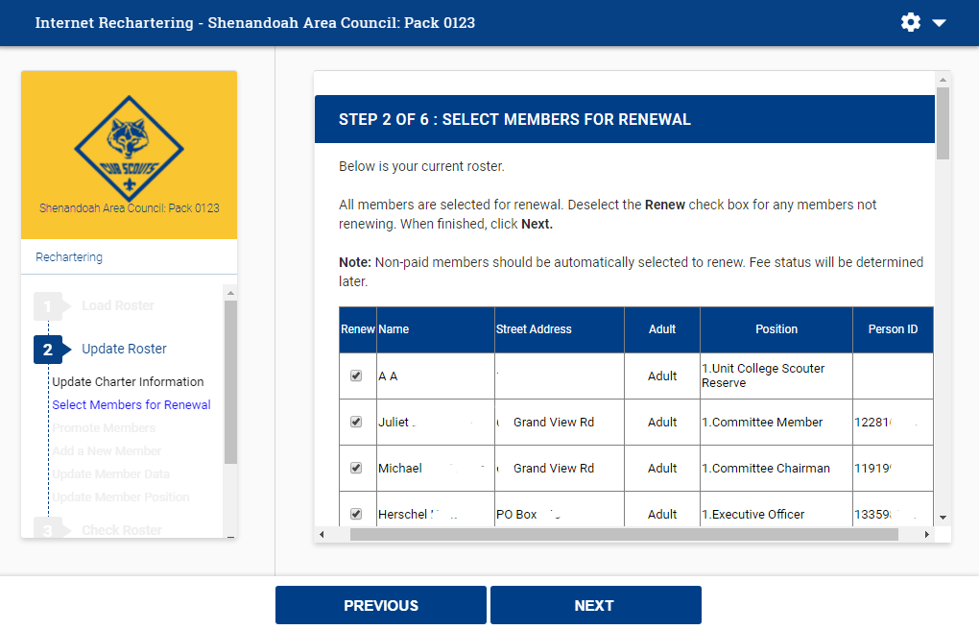
New Branded Look and improved navigation
Notes:
Pat: I know that the access codes will still be distributed by Councils, the unit processor will go in as a first time user and register on the system and then can return using their access code and password. And the councils will still get the same reports they have received in the past. So what is changing Debra?

Slide 4
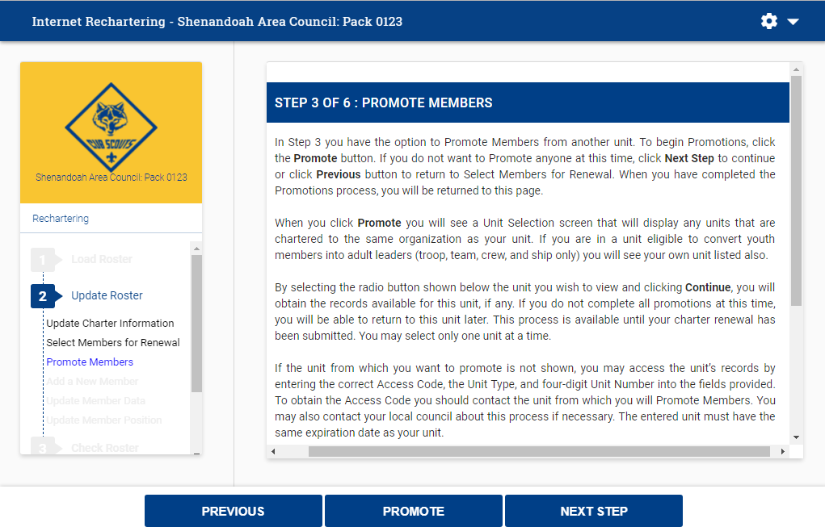
Promote Members within Chartered Family – or with unit access code
Notes:
Pat: I know that the access codes will still be distributed by Councils, the unit processor will go in as a first time user and register on the system and then can return using their access code and password. And the councils will still get the same reports they have received in the past. So what is changing Debra?

Slide 5
Youth Protection Training will be Required for each adult volunteer on the recharter
Notes:
Pat: I know that the access codes will still be distributed by Councils, the unit processor will go in as a first time user and register on the system and then can return using their access code and password. And the councils will still get the same reports they have received in the past. So what is changing Debra?

Slide 6
Unit Renewal Reports – Full and Summary – will remain available for use as needed.
Notes:
Pat: I know that the access codes will still be distributed by Councils, the unit processor will go in as a first time user and register on the system and then can return using their access code and password. And the councils will still get the same reports they have received in the past. So what is changing Debra?

Slide 7
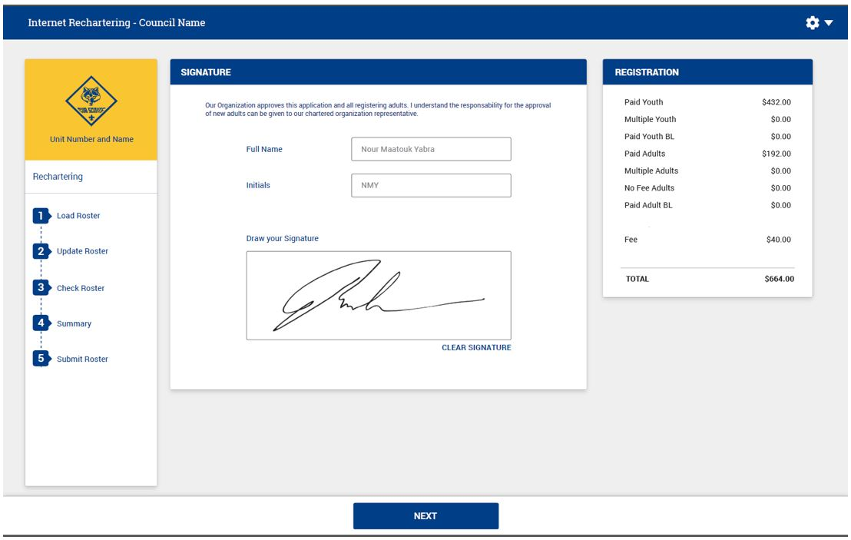
Electronic Approval
Notes:
Pat: I know that the access codes will still be distributed by Councils, the unit processor will go in as a first time user and register on the system and then can return using their access code and password. And the councils will still get the same reports they have received in the past. So what is changing Debra?

Slide 8
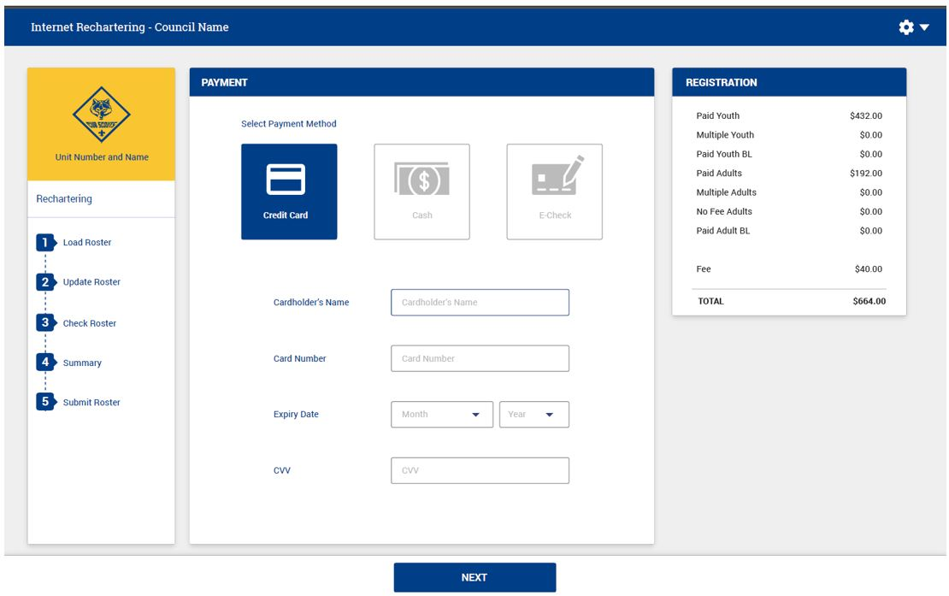
Electronic Payment
Notes:
Pat: I know that the access codes will still be distributed by Councils, the unit processor will go in as a first time user and register on the system and then can return using their access code and password. And the councils will still get the same reports they have received in the past. So what is changing Debra?

Slide 9
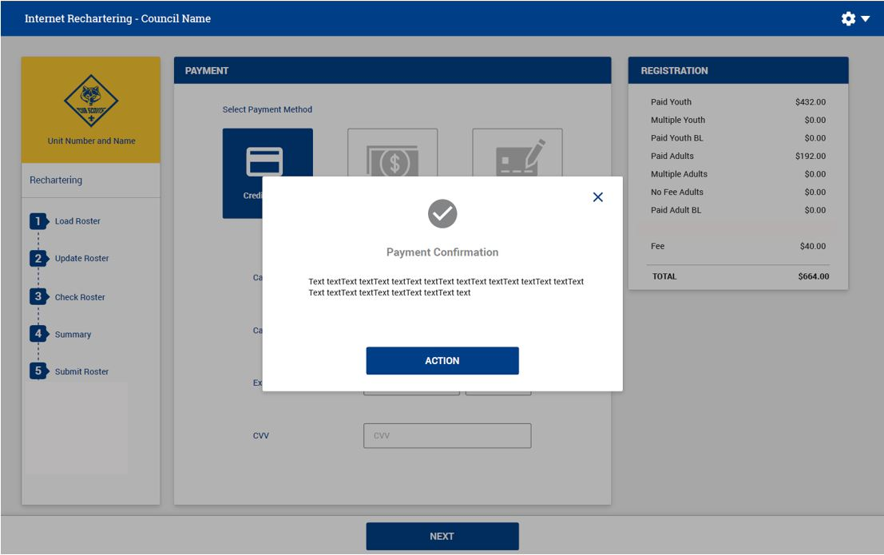
Payment Confirmation

Slide 10
Questions
Please contact your Council for information.

