Slide 1

Troop 088
Scout & Parent Guide
Sale runs now through
Nov 4th
Wagon Orders end & are due: 10/28
Storefronts end: 10/27
Online Ordering ends: 11/3

Slide 2
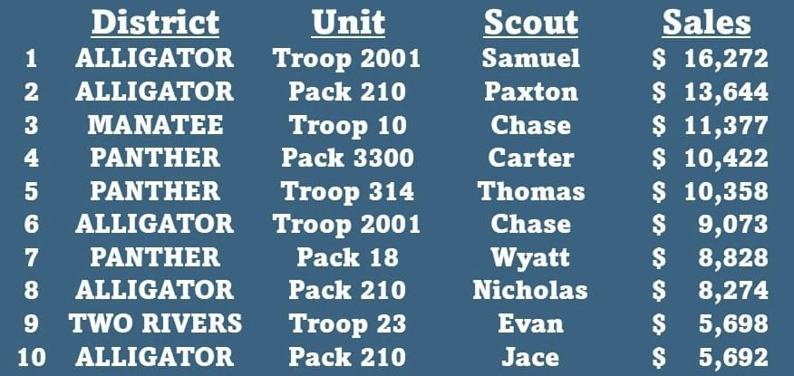

If you say you DON’T WANT to fundraise with Popcorn...
I’ll accept it but I’d love the opportunity to chat & help change your mind!
But if you say you CAN’T sell Popcorn, for any reason including
“You’re not a cute little Cub Scout.”
I’m here to tell you, THAT’S JUST NOT TRUE!
5 of the 10 top sellers 2023:
BSA Scouts
Top 10 sellers sold: $99,638
Top selling BSA Scouts sold: $52,778
Over 50% sold by BSA SCOUTS

Slide 3


HOW
do you sell
Popcorn?
WHY
should you sell
Popcorn?
Online Direct Orders
direct customers to your online account,
Trail’s End ships the order
directly to the customer
Wagon Sales
you take the order, collect money &
hand deliver product to your customers
in November
Storefront Sales
table set up in the front of store
with product
To help fund your Scout Account
To win Prizes
Raise the money so you don’t have to
reach in your own pocket for the money!

Slide 4





Heroes & Helpers Donations
Supports the Scout financially
the same way selling a bag of popcorn does, but instead of the customer
purchasing popcorn for themselves,
they make a donation in ANY amount ($1-$100+) and that money is used to collectively purchase popcorn
that is delivered: locally, across the
US and to bases overseas for our
Troops, Veterans &
First Responders.
WHAT
are we selling?
Popcorn
Popcorn options-
$15-$25
*see order form or app for all options
So, Yes...
When doing this fundraiser,
you may solicit popcorn and
Heroes & Helpers donations.

Slide 5

The Trail’s End APP
To participate in the fundraiser,
you MUST download the app
& enter all orders into the app.
Once you are signed in:
1. Tap 3 lines in upper left-hand corner
2. Tap Manage Page
3. Fill in ‘About Me’, choose your favorite product, upload photos and a picture of yourself in uniform
4. Share your page: is at the bottom of Manage Page. This is where you can text, copy or post it directly to social media accounts you use on your phone
5. Text it to yourself to see if you’re happy with the way it looks
To Download Trail’s End APP:
Text APP to 62771
If you already have the app, it is the same log in & password as in the past.
If you are setting up a new account,
please be sure to answer these questions correctly:
Council: Southwest Florida Council
District: Panther District
Unit: Troop 088
(very important you pick Troop, not pack or crew)
If you are using an account previously created,
it is VERY IMPORTANT you go into Settings, Change Unit and confirm
you are signed in with the above Council, District, Unit info.
**Multiple parents and Scout can download the app but you must ALL use the same
username and password for your Scout's account in the app.One person should create
the account and then share the username and password with the others.**
THE EASIEST WAY TO LEARN THE APP IS TO GO IN & PLAY WITH IT! There are trainings & resources in the APP.

Slide 6



Benefits & Rewards
aka PRIZES!
You will earn a 30% commission on all Online Direct orders. This will be deposited into your Scout Account in December.
You will earn a 31-33% commission on all Wagon & Storefront
orders. This will be deposited into your Scout Account in December.
Trails End prizes: all credit card sales receive 1.25 points,
all cash sales receive 1 point per dollar. Those points can be redeemed for Amazon gift cards. *See prize sheet with order form.
Council prizes: Patches, Top Sellers Day, Free Park Tickets all
with minimum sales. *See prize sheet with order form for details.
Some popcorn activities may count toward earning Merit Badges like:
Salesmanship~Entrepreneurship Art~Computers~Photography
*be sure to consult with your merit badge counselor

Slide 7
Let’s talk REAL numbers...
Connor sold $3677 ($3603 storefront/$74 online)
Connor put $1209.71 in his Scout Account
He also received: 3 patches, a medal, Top Sellers Day,
2 free park tickets and a $250 Amazon Gift Card.
Connor worked 7 storefronts, a total of 23.25 hours.
His HOURLY return to his SA was $51.13
Victor sold $2375 ($2019 storefront/$167 online/$189 wagon)
Victor put $775.40 in his Scout Account
He also received: 3 patches, a medal, Top Sellers Day,
2 free park tickets and a $100 Amazon Gift Card.
Victor worked 6 storefronts, a total of 13.5 hours.
His HOURLY return to his SA was $48.55
Sample Yearly Scouting Costs:
(These are not actual costs in all cases. Guesstimates used for presentation purposes.)
Recharter 80
MOSI 80
Rainbow Springs 50
Cayo Costa 65
Patrol Campout 30
Winter Camp 180
Daytona 30
Troop Tee 20
Camporee 25
Crossover 30
Disney 50
Myakka 30
Summer Camp 444
Yearly Total $1114
...you CAN fund your scouting year!

Slide 8
And after ALL of this…
I’m going to tell you
NOT to sell popcorn!
Let’s do this!
To Maximize your profits,
Scouts will work one Scout per shift.
Scout will provide:
table, signage, change fund
Your Popcorn Kernel will help:
secure location, time & provide product
(I will also track cash & inventory and perform
all behind the scenes functions.
Scouts will plan, prepare and sell. I will manage.)
Several storefronts are prebooked,
find them in your APP. If sites are not
claimed by any Scouts within 7 days of the scheduled storefront, they will be released back into they system for other Scouts in the area.
Put on your Field Uniform.
Put on a Smile!
And sell yourself & SCOUTING!
“Hello! Would you like to support my scouting journey
through the purchase of popcorn or donate to
our troops & local heroes and helpers?”
“Hi! Can I count on your support to help send
me to camp? I’m selling popcorn and taking
donations for our troops!”
They can’t say YES, if you don’t ask!
Regardless of their answer…
Always give a heartfelt
Thank You and have a great day!

Slide 9


Never fear! If you need any help or have any questions…
I am here! Text, Call or Email with any questions.
(Please be sure to include your parent or another adult leader in any communications.)
Popcorn Kernel 239-XXX-XXXX
YOURpk@gmail.com
Trails End Customer Support
support@trails-end.com
(don’t forget the dash)

