Slide 1

Welcome to our
Pack 088
Kickoff
Sale runs now through
November 4, 2025

Slide 2

Popcorn also supports our COUNCIL
And we ALL make up our
local SWFL council.
When you go to an event at
Camp Miles & Camp Flying Eagle
your Scout will enjoy:
•Shooting Sports •Archery •Boating •Rock Wall Climbing •Swimming
•so much more!
When our Pack sells Popcorn everyone wins!
WHY do we sell
Popcorn?
To make our Pack 088
program the best that it can be!
We use TEAMWORK to fund our Cub Scout program for the ENTIRE year!
We use our commissions to buy all the things:
awards, den supplies, trailer supplies, derby cars, pizza
parties, donuts, rockets and so much more!
We don’t charge ANY dues…
We Sell Popcorn.

Slide 3

Storefront
(Show & Sell)
table set up in the front of store
with product
Wagon
(Take Orders)
you take the order, collect money &
hand deliver product to your customers
in November
Online Direct
(Online)
direct customers to your online account,
Trail’s End ships the order
directly to the customer
HOW
do we sell
Popcorn?

Slide 4




Storefronts
4 Locations: Bass Pro Shops, Publix, Lowe’s & Walmart
6 Saturdays: Aug 31, Sept 7,14 ,21 & Oct 5, 12
5, 2 hour shifts per location & 1-2 Scouts per shift
4 shifts per scout = only 8 hours of your time
100% participation
Teamwork, makes the dream work!

Slide 5







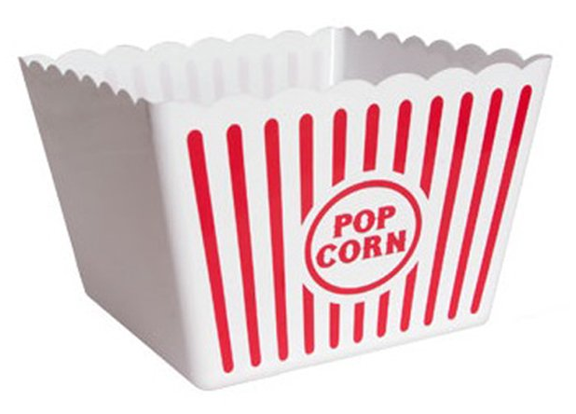
Storefront Product Line Up
Heroes & Helpers Donations
Supports our Pack financially
the same way selling a bag of popcorn does,
but instead of the customer purchasing
popcorn for themselves
they make a donation in ANY amount
($1-$100+) and that money is used to
collectively purchase popcorn that is delivered: locally, across the US and to bases
overseas for our
Troops, Veterans &
First Responders.
Tried and True...we already know these products
are winners!

Slide 6
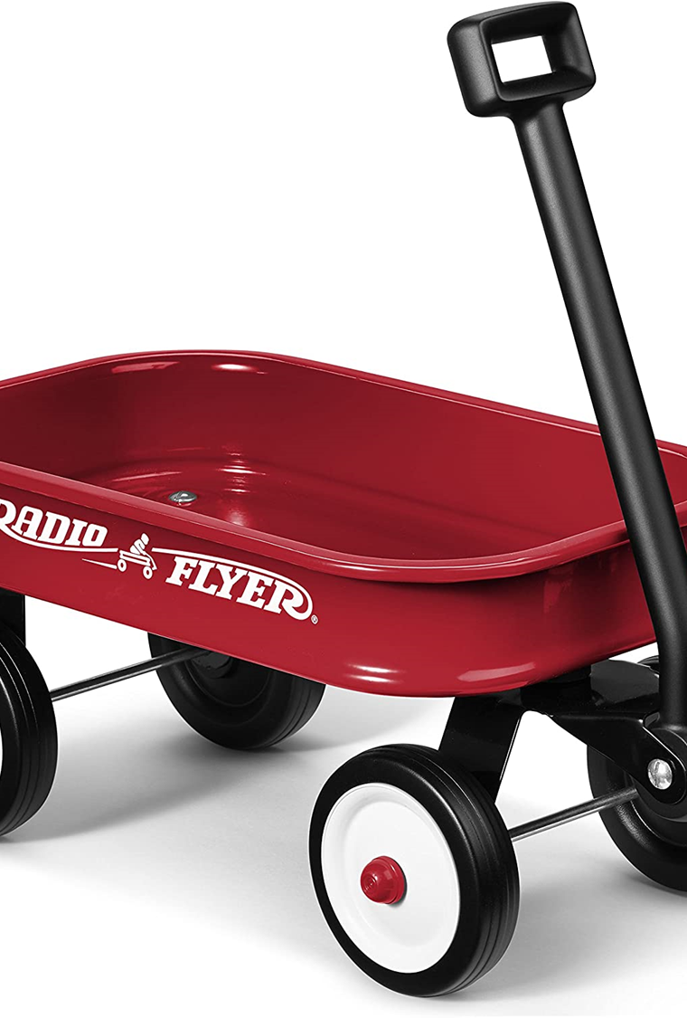
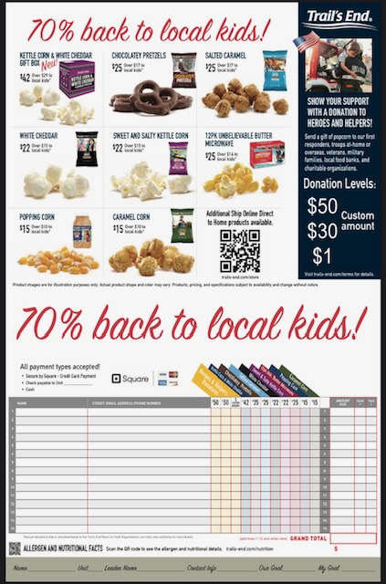
Wagon
Sales
•You take the order
•You collect payment at time of order-
Cash, Check (made out to Pack 088) or Credit Card through the Trails End APP
•You may use Paper Order Form as a SALES AID, but you must input all Wagon Sales into App
(even if you initially took them on paper)
•You hand deliver the order to your customer in late November
All Wagon Sale Orders & money must be turned in by
October 28th, 2024.

Slide 7
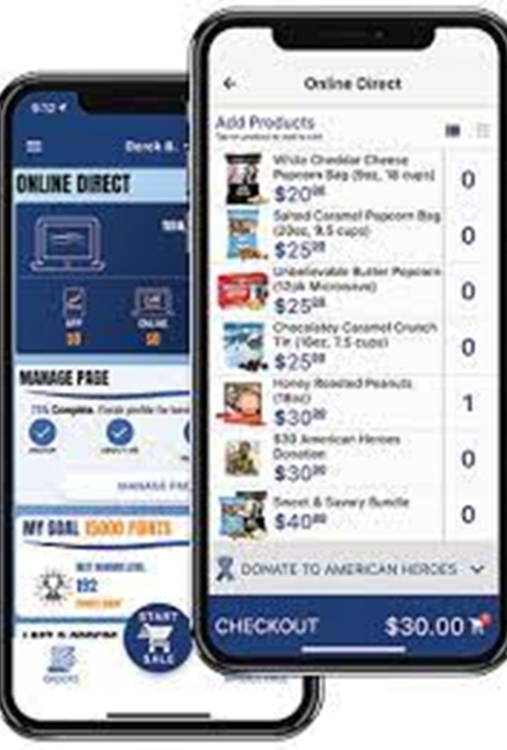
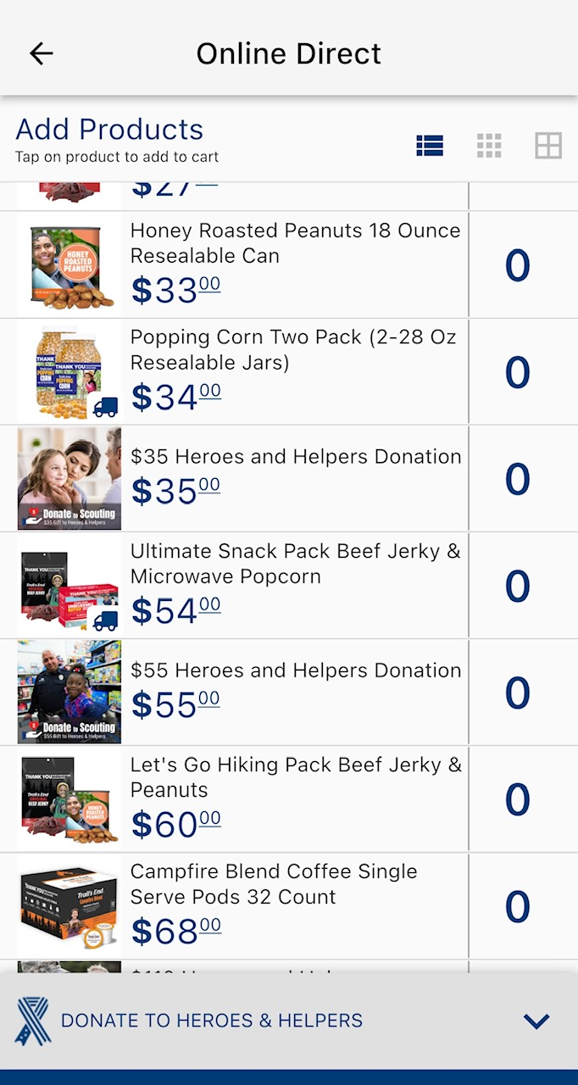
Online Direct Sales
•You direct customers to your personal popcorn page through the Trail’s End APP
•Customers place their order online
•Trail’s End delivers the order to your
customer in about 7 days
•Shipping is FREE on all orders over $65
This is the EASIEST way to sell!
Online Direct
also offers additional
products not available through Storefront or Wagon Sales.
Honey Roasted Peanuts, Trail Mix & more!

Slide 8

Ask EVERYONE you know to support you
We have bags of popcorn that start at $15. We also accept heroes and helpers donations in any amount. No donation is too small!
Text and call your family and friends
Create signs with QR codes for parents workplaces or to hang at the clubhouse in your community
Create a sign with a bucket asking for heroes and helpers donations at your workplace
Go door to door in your neighborhood
or desk to desk at parents office
Go claim your 4 storefront shifts!
Do Your Best!

Slide 9

Let’s start here!
Download Trail’s End APP:
Text APP to 62771
If you already have the app,
it is the same log in & password as last year.
Once you are signed in:
1. Tap 3 lines in upper left-hand corner
2. Tap Manage Page
3. Fill in ‘About Me’, choose your favorite product, upload
photos and a picture of your Scout
4. Share your page: is at the bottom of Manage Page. This is where you can text, copy or post it directly to social media
accounts you use on your phone
5. Text it to yourself or ‘Visit My Page’ to see if you’re happy with the way it looks
6. There are lots of great training videos in the APP. From the Menu, choose Training
Ohmigosh!
How do I use the
Trail’s End APP?
THE EASIEST WAY TO LEARN THE APP
IS TO GO IN &
PLAY WITH IT!

Slide 10

Trails End Prizes (by points)
All tracked in APP
Redeemable for Amazon Gift Cards
APP points vs dollars
Now Let’s Talk…
PRIZES!
SWFL Council Prizes (by dollars)
Patches & Medal
AWESOME Top Seller’s Day
($1,300, not 1300 points)
FREE park or event tickets at $1,650
(see insert with order form)
3 PRIZE Packages
Trail’s End,
SWFL Council
& Pack
Pack 088 Prizes (by dollars)
What? Three levels of Prizes!
Next, we’re going to do a Scout Activity
and discuss our Pack level Prizes

Slide 11

Calling all Scouts…
Let’s Plan & Practice
& then let’s Play!
Worksheet
Goal Setting: Do Your Best
Unit Prizes
At home, practice your pitch:
Hi! Would you like to support my Cub Scout Pack?
We’re selling popcorn and collecting
donations for our Troops!
AND, in addition to allllll of these great prizes…
We do some “pop up” challenges!
Let’s kick off this selling season with our first challenge!
And a prize...of course!
Every Scout who logs $200 or more in their APP through wagon or online direct sales in the next 2 weeks,
will earn a super fun prize! Are you up for the challenge?

Slide 12
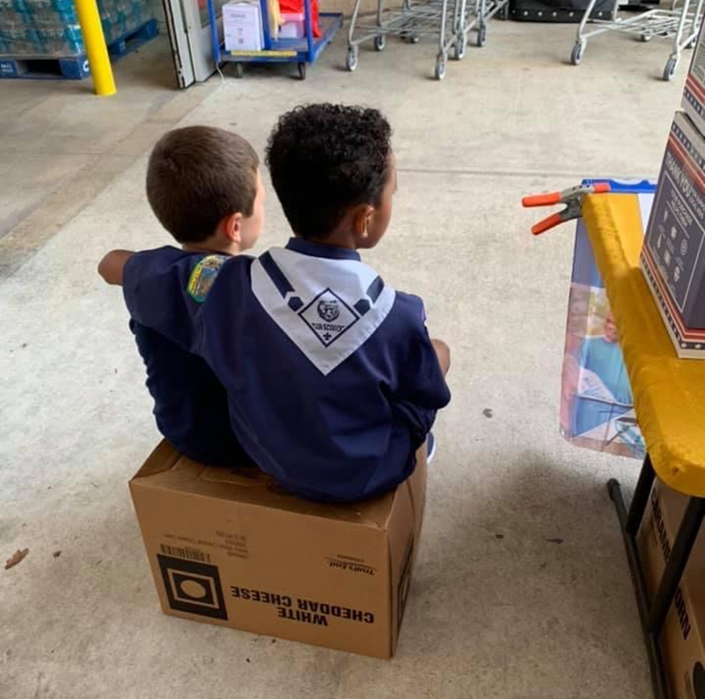
Throughout this fundraiser...
Scouts...
have fun & are excited for prizes.
learn to make eye contact.
use their manners.
come out of their shell & grow.
are okay with someone saying No and they will thank them anyway.
will witness generosity like they have never seen.
will get positive reinforcement from customers telling them they are doing a great job.
This fundraiser is going to be a HUGE success
that all of our Scouts will benefit from
both financially & in life skills.
The key is TEAMWORK!
THANK YOU for your commitment
to our great Pack 088!
Parents,
Let’s get that APP downloaded and
your shifts claimed.
And Scouts,
Let’s play some Popcorn Games!

