Slide 1

SOUTHWEST FLORIDA COUNCIL
FORT MYERS
FLORIDA
Text APP to 62771 NOW!!!!!

Slide 2

SWFL Council Prize Program
  Awesome Top Seller Day Feb 25th!
  Patches
  Theme Park Tickets

Slide 3
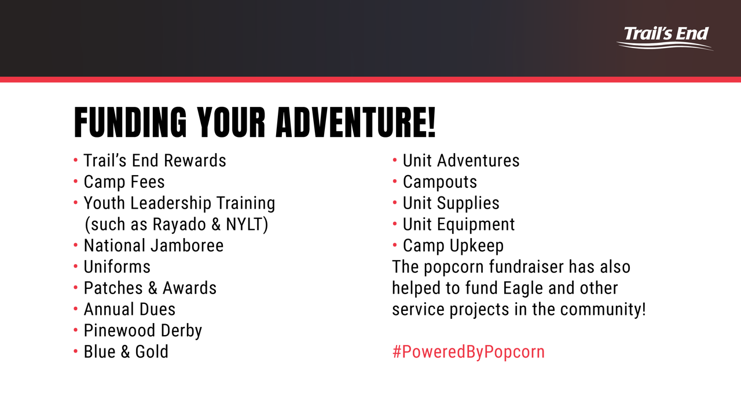
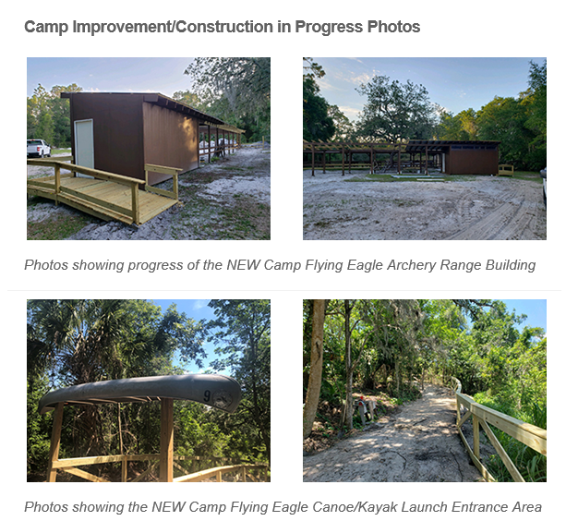

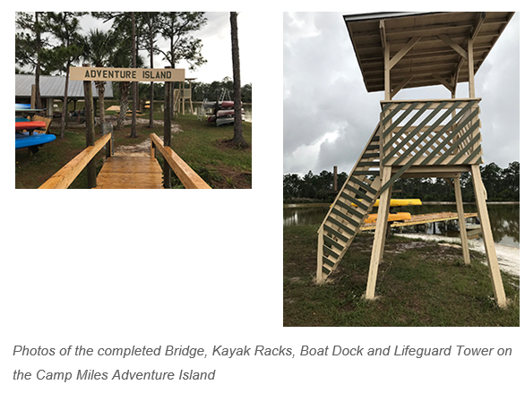
WHY DO WE SELL POPCORN?
Why Popcorn? Benefits our scouts!

Slide 4
Why Popcorn?

Slide 5
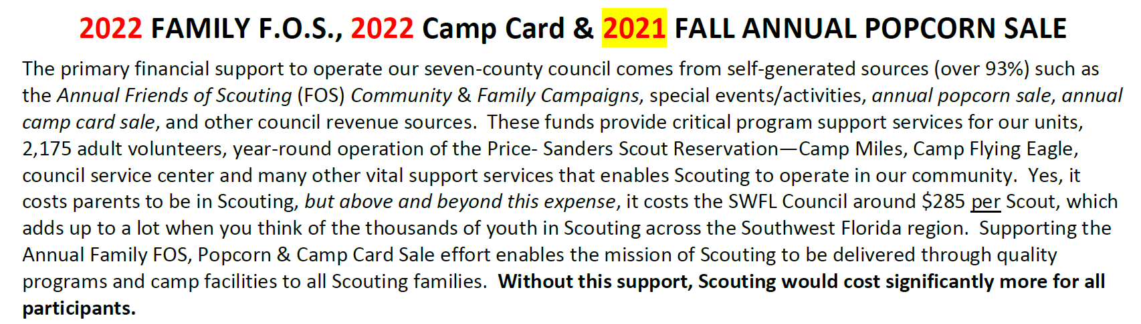

Why Popcorn? 2022 Unit Recognition
2023
2023
2023

Slide 6

2021 Review - Top Units
UNIT | SHOW-N-SELL | ONLINE | TAKE ORDER | TOTAL SALES
1. Two Rivers Pack 26 | $19,350.00 | $3,689.27 | $7,898.00 | $30,937.27
2. Panther Pack 3300 | $10,005.00 | $13,545.48 | $7,545.00 | $30,210.48
3. Alligator Pack 243 | $10,440.00 | $2,400.42 | $3,897.00 | $16,737.42
4. Manatee Pack 125 | $4,440.00 | $6,418.48 | $1,098.00 | $11,956.48
5. Two Rivers Pack 13 | $10,080.00 | $1,254.68 | $0.00 | $11,334.68
6. Panther Pack 761 | $6,555.00 | $1,694.55 | $1,765.00 | $10,014.55
7. Alligator Pack 226 | $7,140.00 | $2,299.48 | $40.00 | $9,479.48
8. Manatee Troop 191 | $2,400.00 | $3,223.94 | $3,455.00 | $9,078.94
9. Panther Pack 18 | $3,060.00 | $2,529.52 | $3,000.00 | $8,589.52
10. Two Rivers Pack 77 | $5,800 | $698.50 | $1,653.00 | $8,151.50

Slide 7
2021 Review - Top Sellers
1. Samuel Arthur | Pack 243 | $10,510.50 |  | 14. Lucius Zack Prince | Troop 433 | $2126.79
2. Isaiah Hartsell | Pack 26 | $8,060.52 |  | 15. Caleb Donnelly | Troop 777 | $2,126.47
3. Dominic Parla | Pack 26 | $6, 569.69 |  | 16. Gavin Hernandez | Pack 3300 | $2,114.00
4. Jace Walsh | Pack 210 | $5,878.80 |  | 17. Israel Blakely | Pack 3300 | $2,074.00
5. Evan Fulton | Pack 1226 | $3,245.00 |  | 18. Gabriel Rivero | Troop 761 | $2,045.00
6. John Cvanciger | Lone Scout | $3,245.00 |  | 19. Devin Valadez | Troop 191 | $1,889.82
7. Wyatt Schelm | Pack 18 | $3,001.94 |  | 20. Christopher Connor | Pack 3300 | $1,870.00
8. Ryan Berkey | Pack 3300 | $2,642.00 |  | 21. Andres Bennett-Garcia | Pack 25 | $1,851.50
9. Carter Stanislaus | Pack 3300 | $2,554.00 |  | 22. Nathan Andreae | Pack 13 | $1,811.83
10. Elijah Jourdan | Pack 26 | $2,520.32 |  | 23. Charlotte Szczepkowski | Pack 243 | $1,809.00
11. L.T. Rice | Troop 52 | $2,469.72 |  | 24. Leo Fistorn | Pack 3300 | $1.805.00
12. Dublin Meter-Rogers | Pack 761 | $2,365.00 |  | 25. Sebastian Andreae | Pack 13 | $1,804.84
13. Christopher Szczepkowski | Pack 243 | $2,126.79 |  | 26. Adam Miller | Pack 25 | $1,800.00

Slide 8

How to Videos: https://www.youtube.com/channel/UC5wc_p4sW6_MQjL25nzFdlA/videos

Slide 9
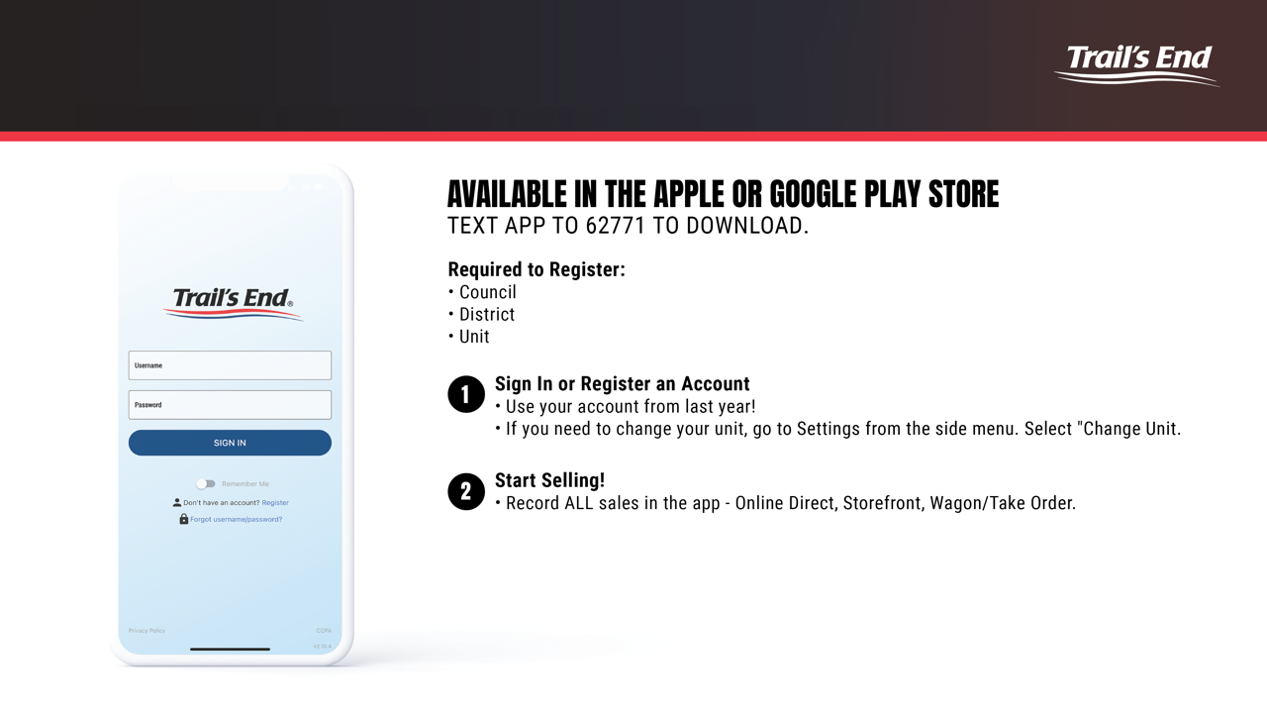
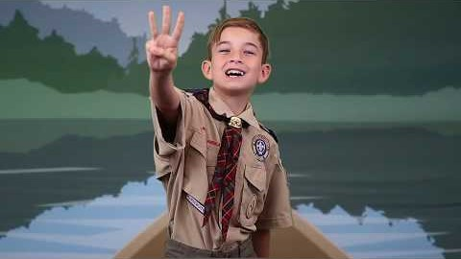
Successful Sale – Scout’s Pitch
https://youtu.be/0XCq7XB6900

Slide 10
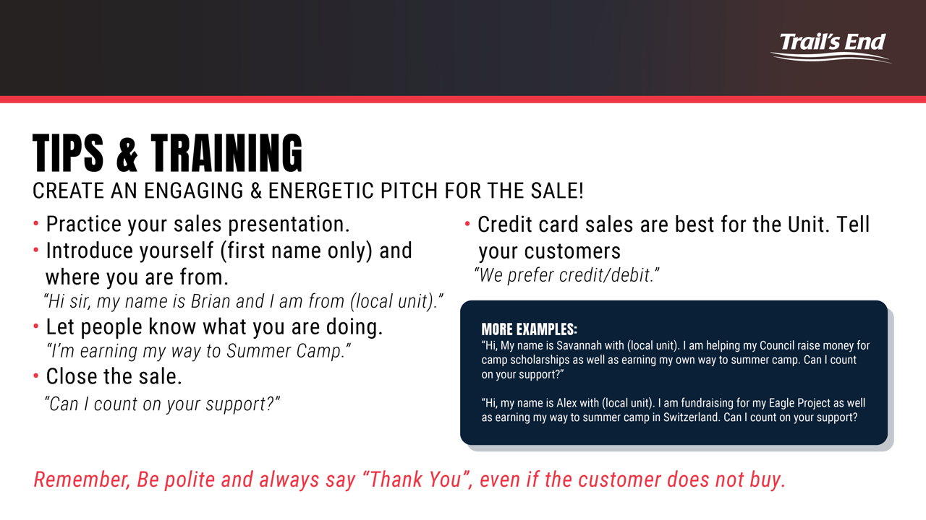
A Successful Sale – for youth

Slide 11
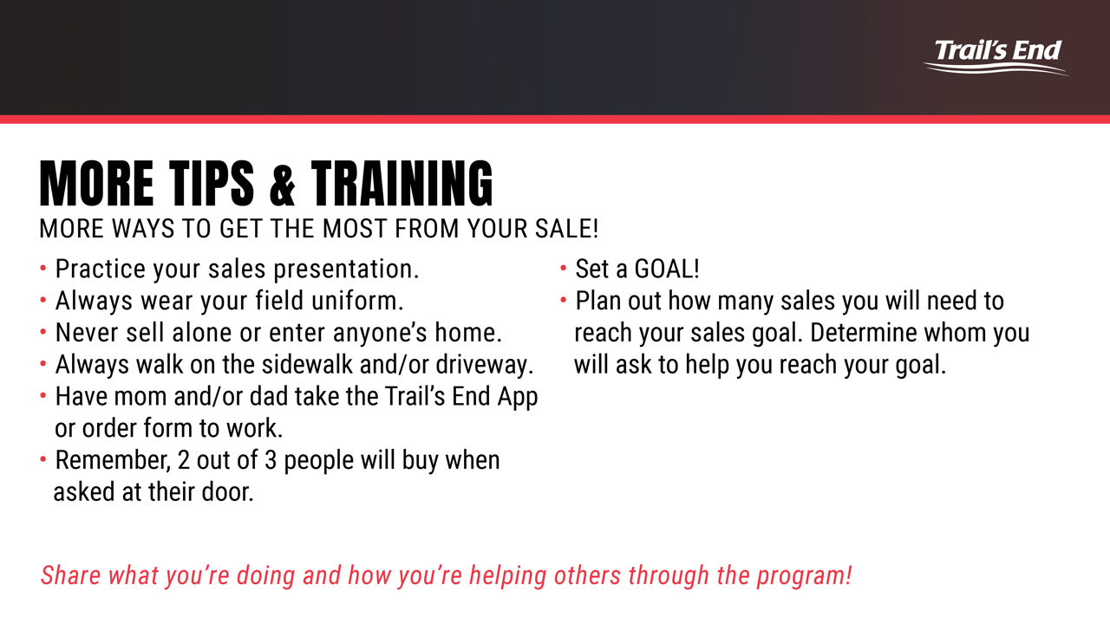
A Successful Sale – for youth

Slide 12
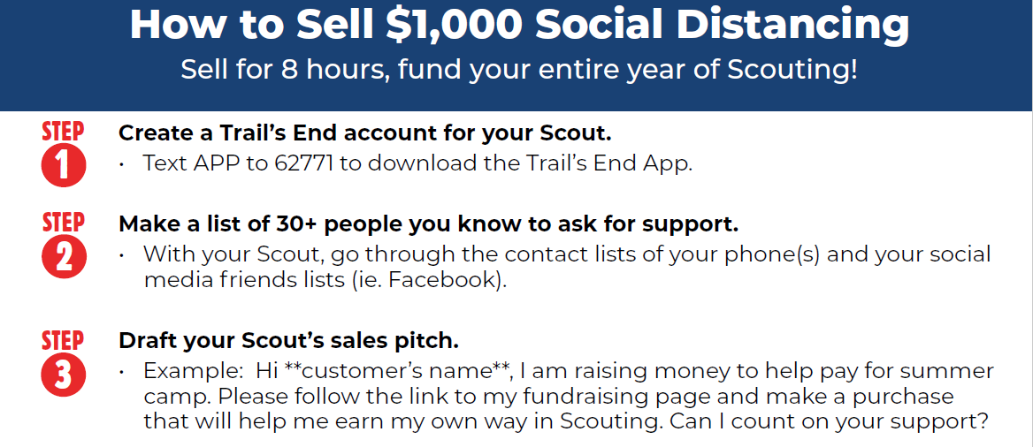

Slide 13
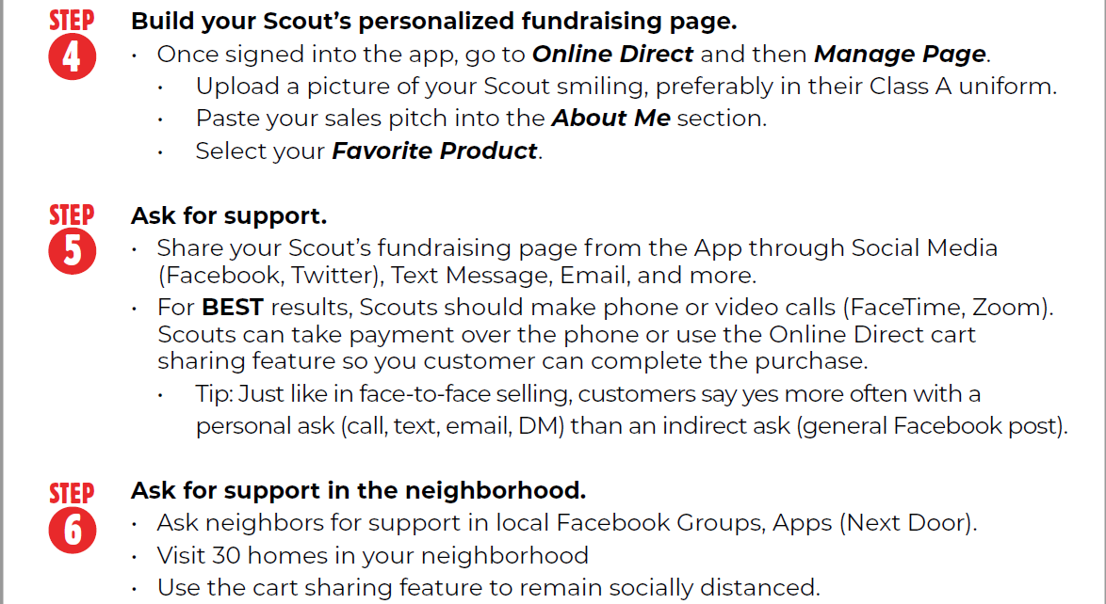

Slide 14


Slide 15
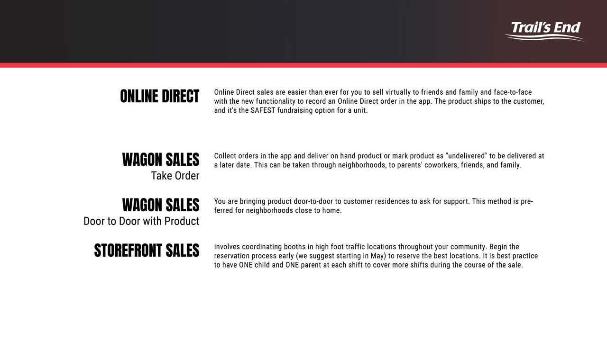
Ways to Sell

Slide 16
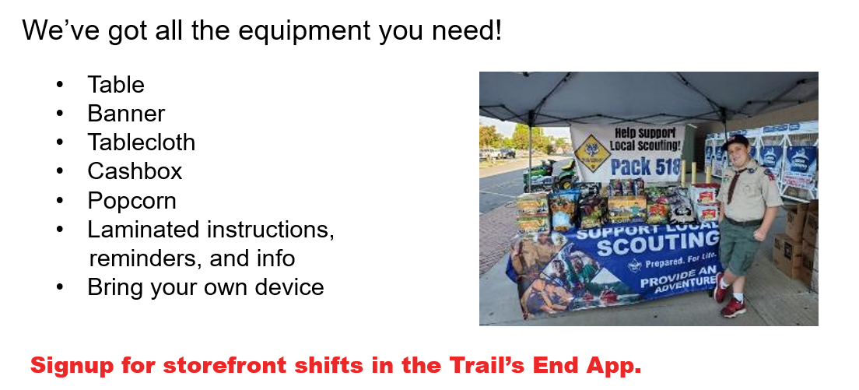
STOREFRONTS

Slide 17
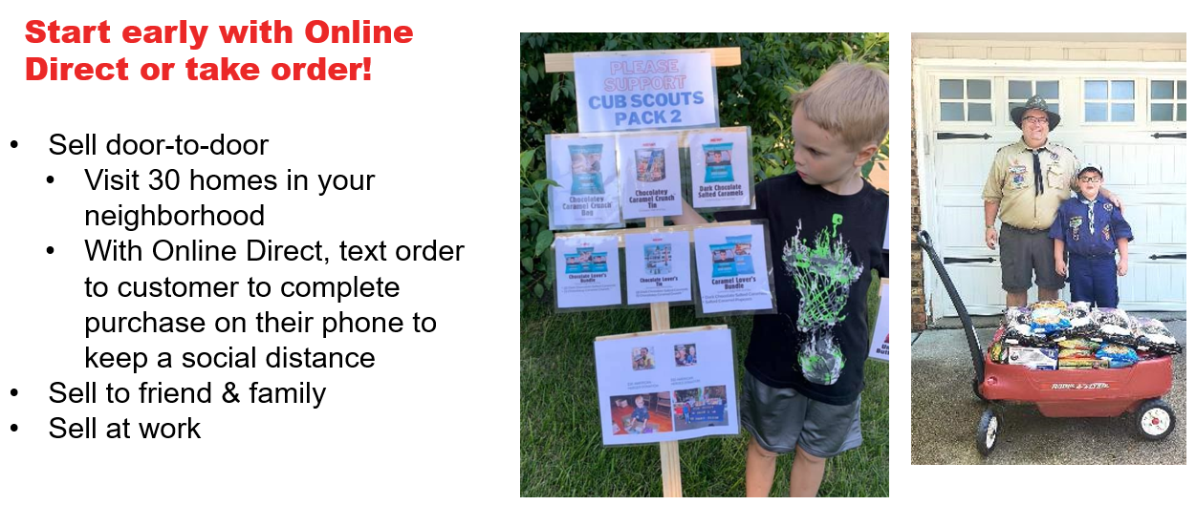
Wagon Sales

Slide 18
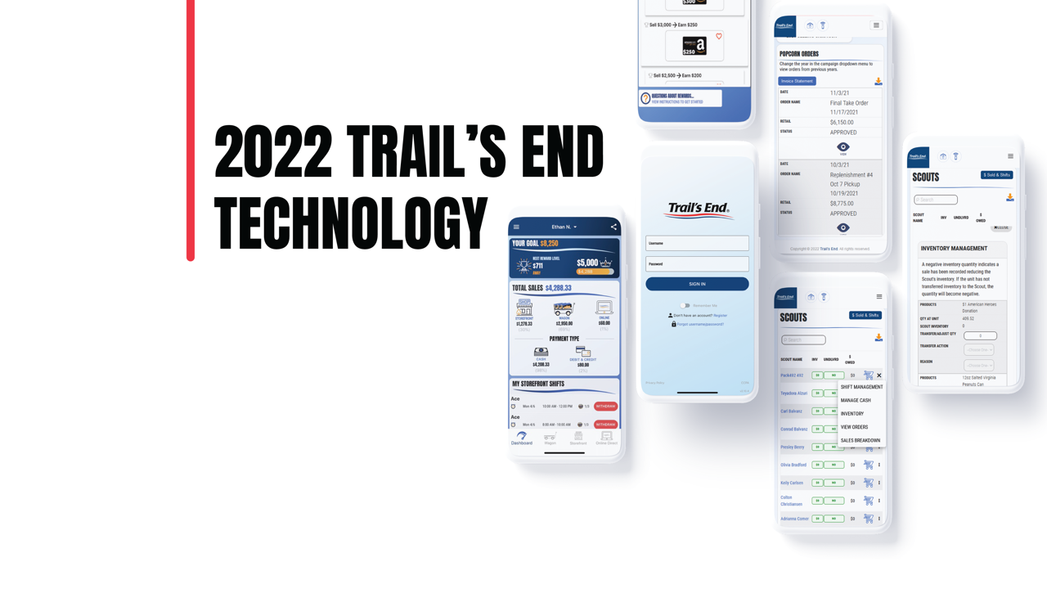
2022 Trail’s End Tech
Easy for Parents & Scouts- access on the go!
Enter ALL sales so that you can qualify for the prizes!
How to Videos: https://www.youtube.com/channel/UC5wc_p4sW6_MQjL25nzFdlA/videos

Slide 19
STOP – Everyone Get the App NOW!!!
Text APP to 62771 NOW!!!!!

Slide 20
Trail’s End Scout App
Multiple Kids?
Each kid must have their own registered account, even siblings.
The same email can be used for multiple accounts
Toggle between accounts within the app by clicking the name dropdown at the bottom of the screen.

Slide 21
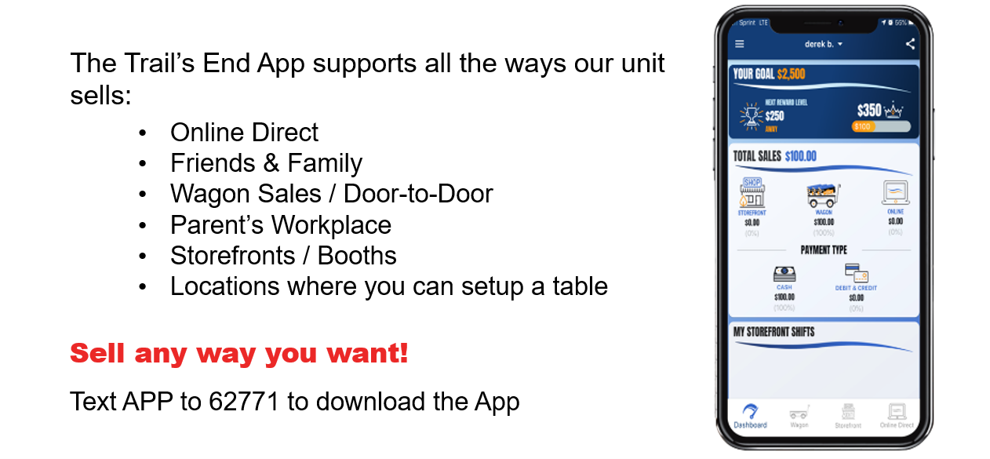
Trail’s End Scout App

Slide 22
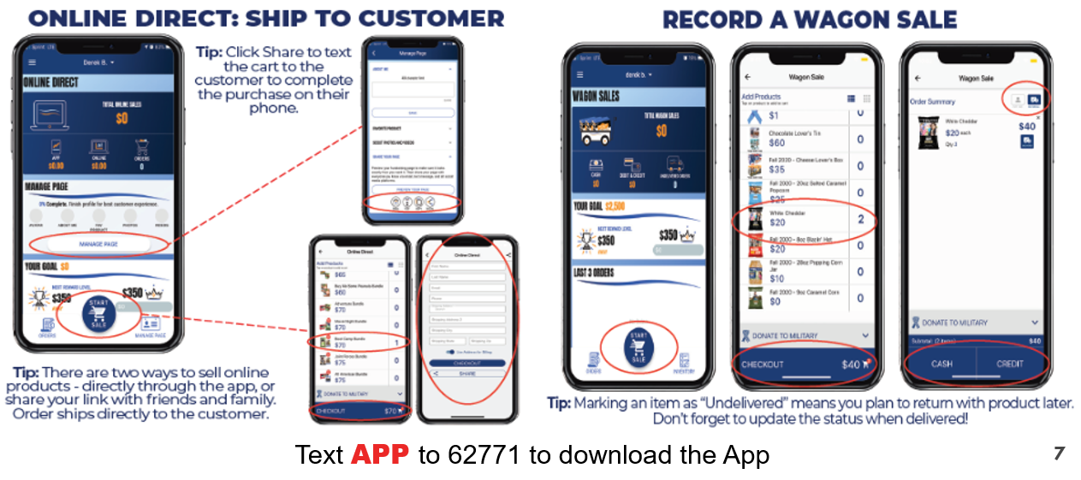
Trail’s End Scout App

Slide 23
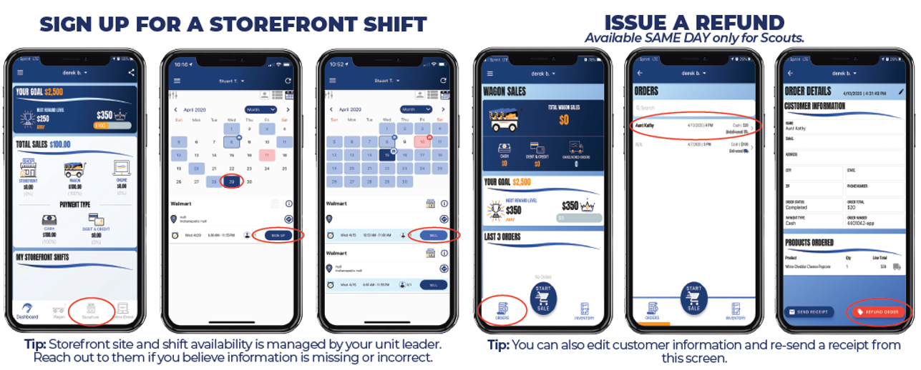
Trail’s End Scout App

Slide 24


Trail’s End Scout App - Autoshare
A Few Things to Remember
If a customer clicks your link, the Autoshare will stop until you AutoShare with them again.
In order to quickly import the contacts in your device, you must give the Trail’s End App access to your contacts.
Allowing access to your contacts is NOT required!
  Manual Entry available.
Trail’s End will NOT access your contacts without your permission; contacts are ONLY for your designated AutoShare activities.
Click for YouTube Demonstration

Slide 25
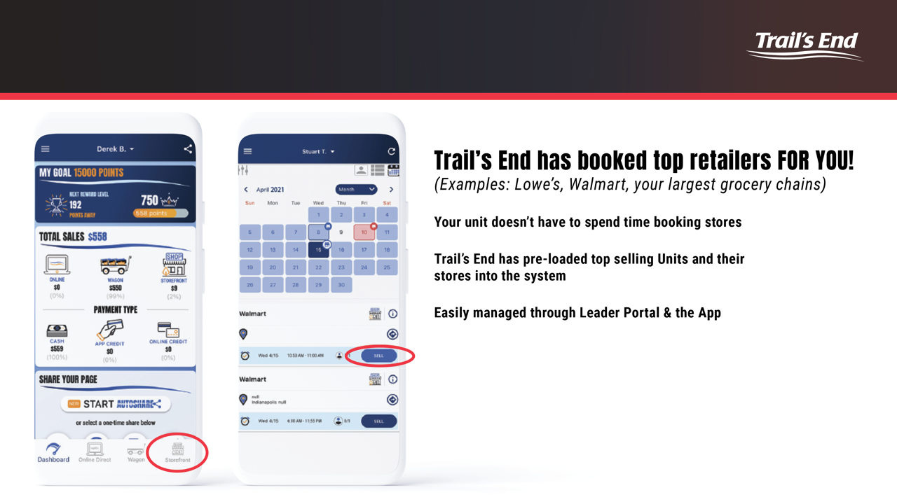
Trail’s End Scout App Storefront

Slide 26
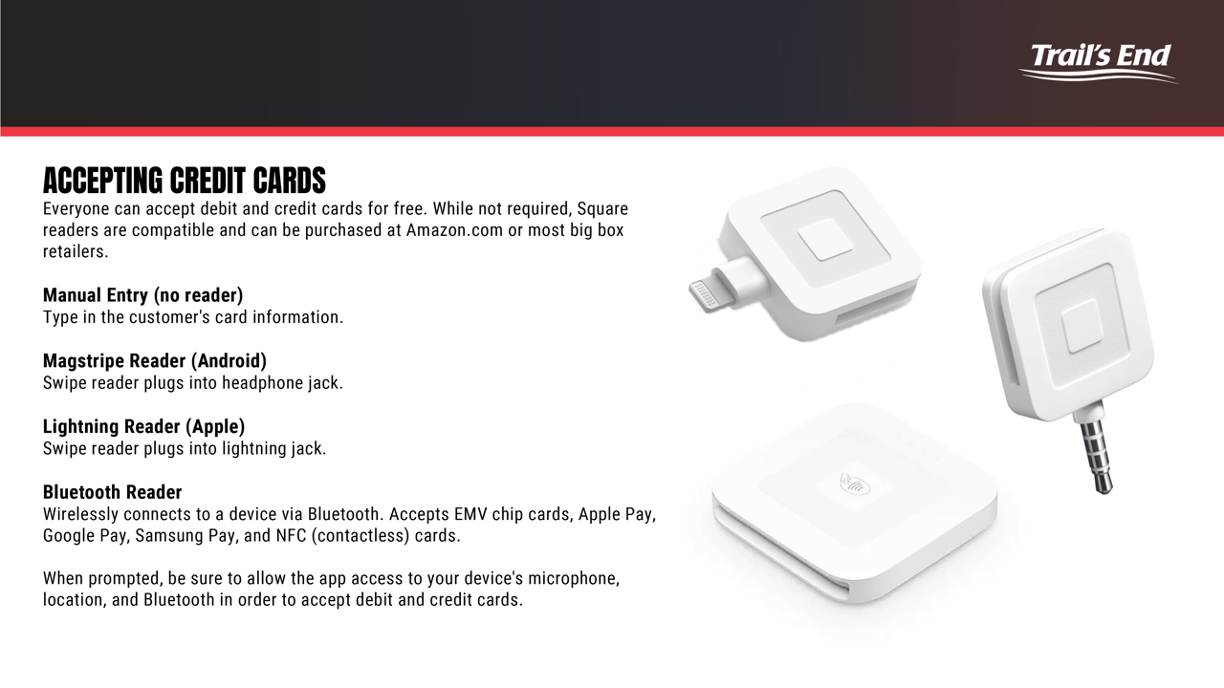
Trail’s End Scout App – Credit Cards

Slide 27
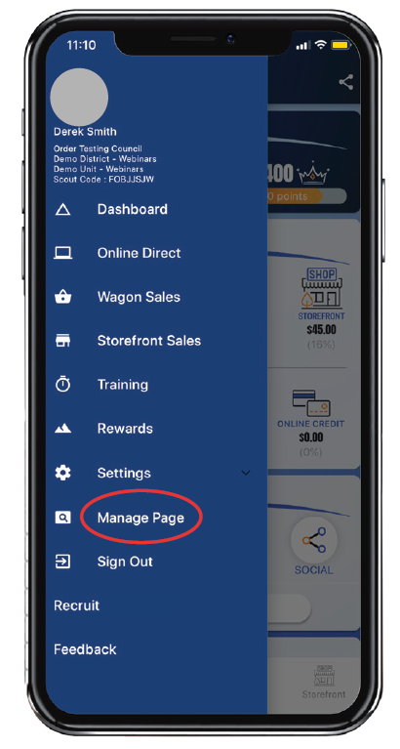
Trail’s End Scout App – Parent Training
Click “Menu” upper left, then “Training”
Videos & How-To’s within the app for parents.

Slide 28


Slide 29
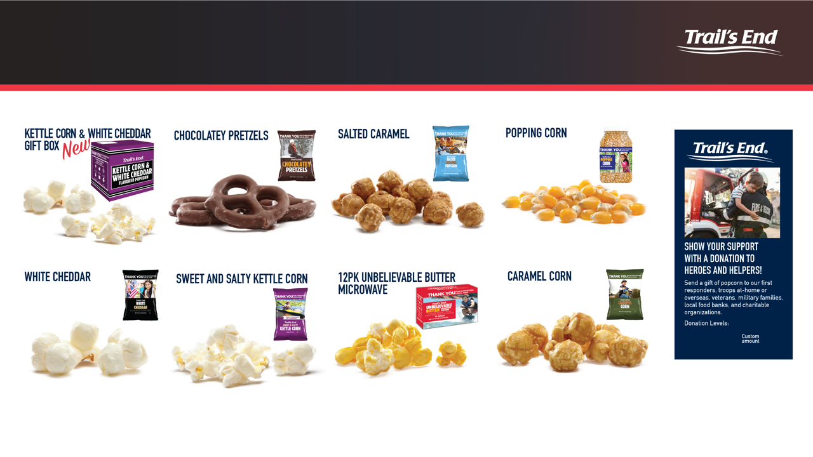
Traditional Products
$25
$25
$15
$42
$22
$22
$15
$25
Notes:
include

Slide 30

AMERICAN HEROES DONATION

Slide 31
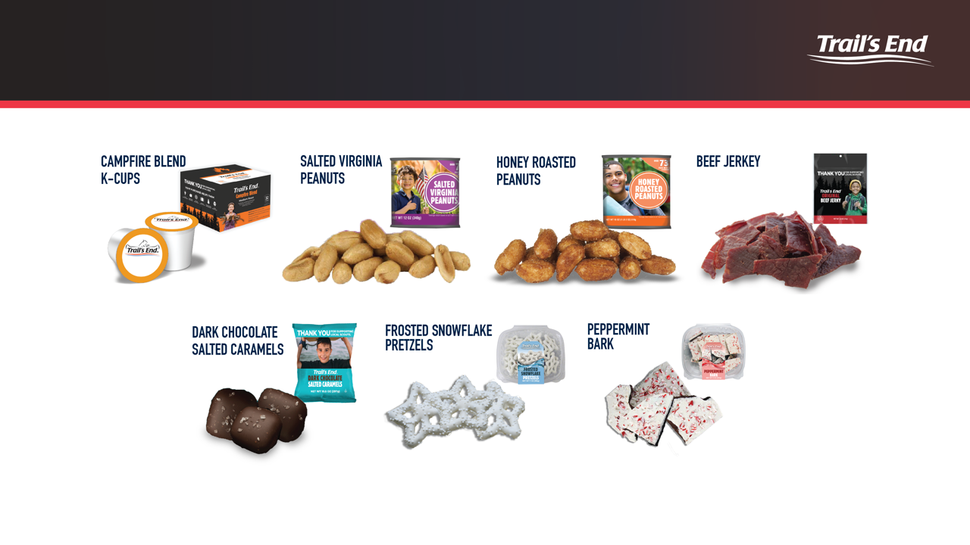
Additional Online Products *
Agenda
* Providing supply chain issues are minimized
Notes:
include

Slide 32


Slide 33

WHY DO KIDS LOVE TRAIL’S END REWARDS
You get to buy the prizes you want!
The more you sell, the more you earn.
Millions of prize choices on Amazon.com.
Get your prizes faster and delivered directly to you.
Bigger and better prizes than ever before!
WHY DO LEADERS LOVE TRAIL’S END REWARDS?
Less work!
No collecting orders from families or distributing prizes.
Simplified sale management.
The Trail’s End Leader Portal is a one-stop shop for everything, including prize ordering.
Orders are tracked automatically for leaders when kids sell with the App and Online.
It’s easy to communicate and manage because face-to-face and online sales count towards Rewards.
Trail’s End helps train and motivated kids through the app.
Leaders can wrap up the fundraiser and get back to unit adventures faster!

Slide 34
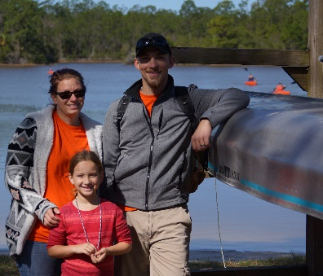
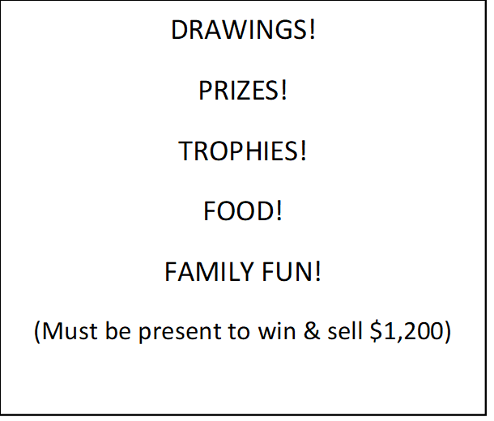
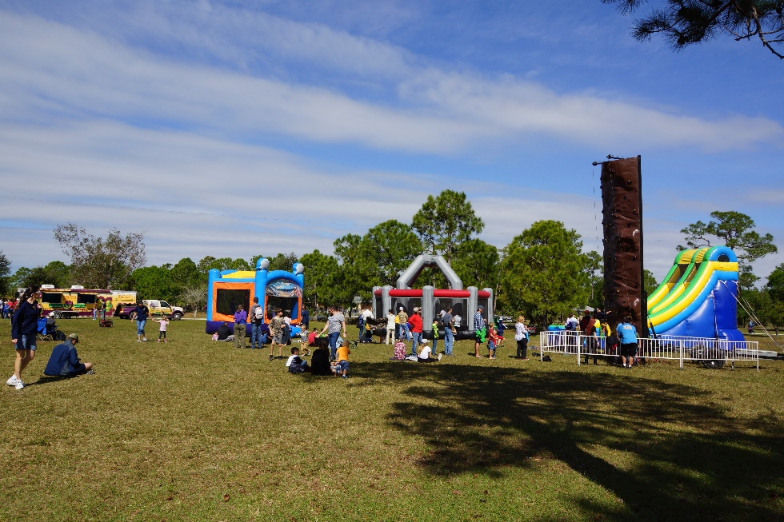
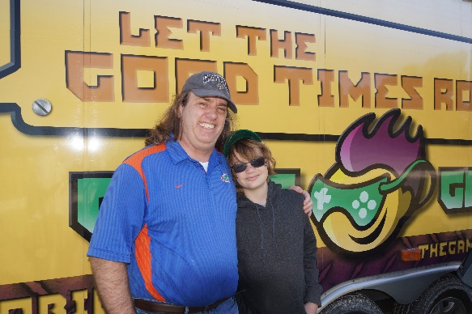
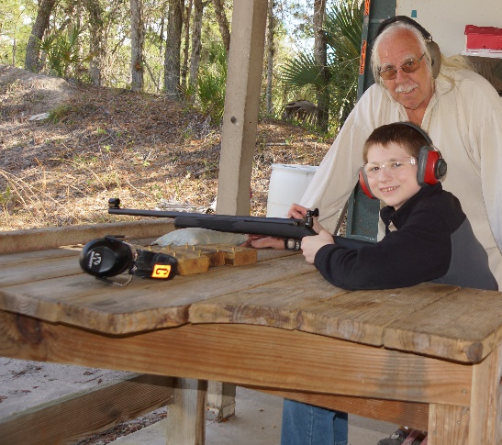
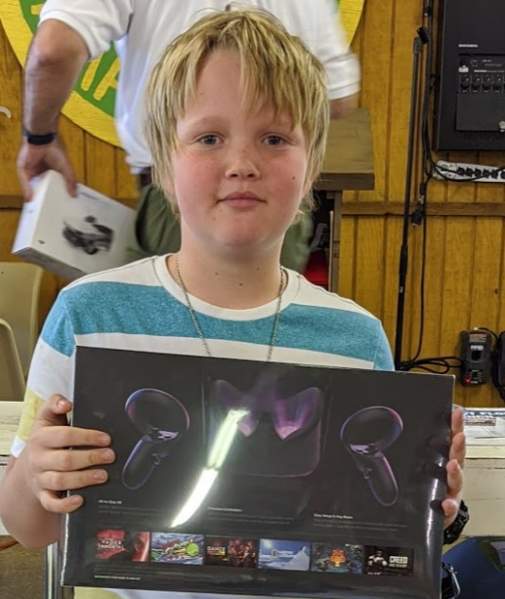
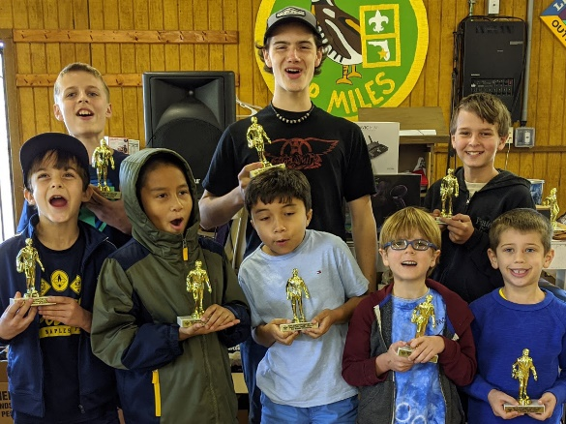
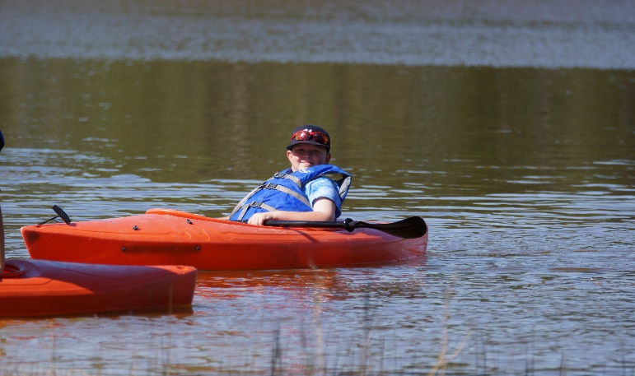
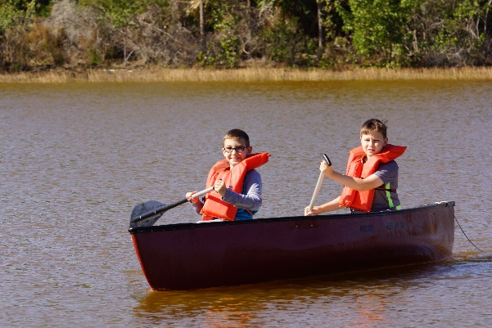
Council Prize Program – Top Seller Day
Notes:
1-2 min

Slide 35



No Prize Forms
No Top Seller Registration
No Theme Park Ticket Order Forms
Accurate Parent information entered into the app is important to receive Council prizes!!!!

Slide 36
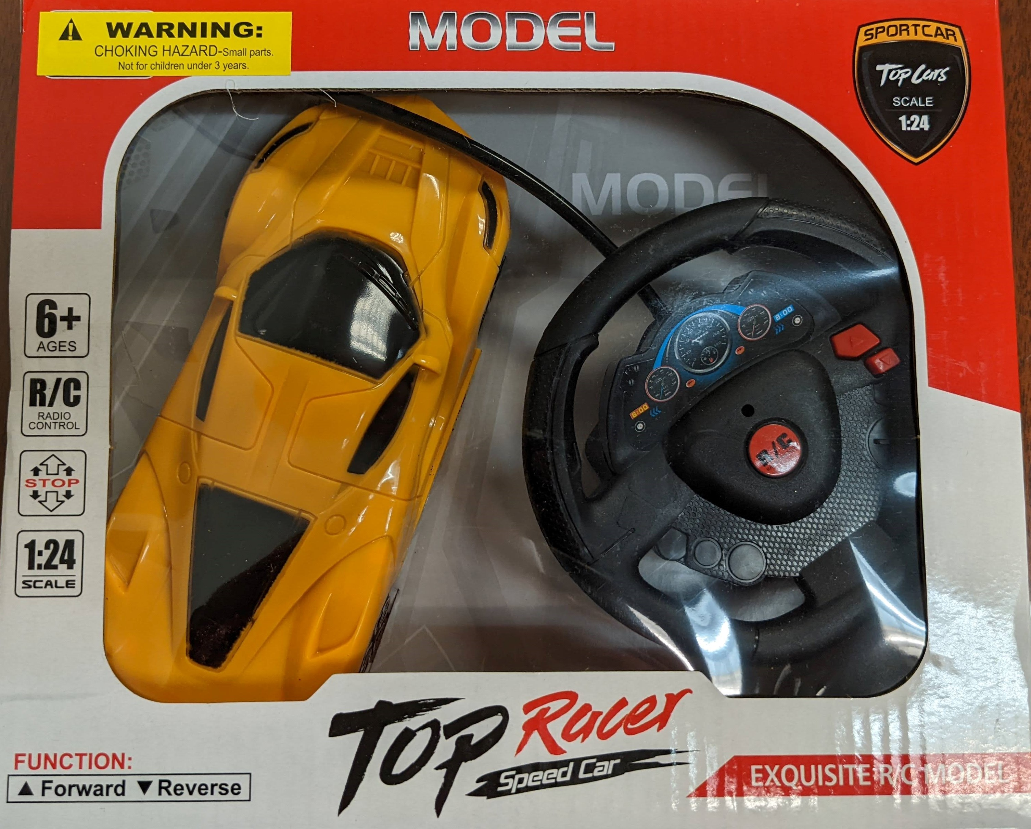
Blitz Weekend Prize – Free to each trained unit!

Slide 37
Our Unit Prizes
Parent Note: Not the responsibility of SW FL Council or Trail’s End
(Kernel must enter their own or delete this slide)
Top Seller: Free January Family Campout & Hiking Stick
2nd Place: Cool Scooter!
Weekly Prizes: Compass, Crafts, lights, multi-tools, & more!

Slide 38
2022 Key Popcorn Dates
Online Direct & Take Order start
Storefront Signups Live (must order Show & Sell physical product)
Wagon Show & Deliver/Storefront product
First Storefront Sale (must order Show & Sell physical product)
Neighborhood Blitz Day
Last Day to Return Popcorn
Last Storefront Sale
Money due
Popcorn Party
August 15th
September 4th
September 4th
September 4th
September
November ___
November ___
November ___
TBD

Slide 39
SUPPORT
CONTACT
TRAIL’S END SUPPORT
JOIN OUR FACEBOOK GROUP
Text SCOUTFB to 62771 to join
JOIN OUR WEBINARS
Text WEBINAR to 62771 to register
VISIT OUR WEBSITE
www.trails-end.com
EMAIL US:
support@trails-end.com
NEED HELP? VISIT OUR FAQs:
www.support.trails-end.com
UNIT CONTACT INFO
Enter Name: Unit Kernel
@gmail.com
(000) 000-0000
Enter Name: Unit Co-Kernel
@gmail.com
(000) 000-0000

Slide 40
Keys to important dates
Backdate your important Dates
    Publish on sale sheets & handout
Take advantage of Trail’s End Trainings and Webinars
Set up unit Trails-end.com account & book storefronts
Set goals
Have an exciting Kickoff
Talk about popcorn at every meeting
Enhance with your own (inexpensive) prizes
Ensure 100% app usage
Help with sort, get popcorn early
Reach out early for help
Get those app & accounts set up by parents!!!
WE ARE HERE FOR YOUR SUCCESS!!!!
Notes:
Update dates

Slide 41


